Slide 1
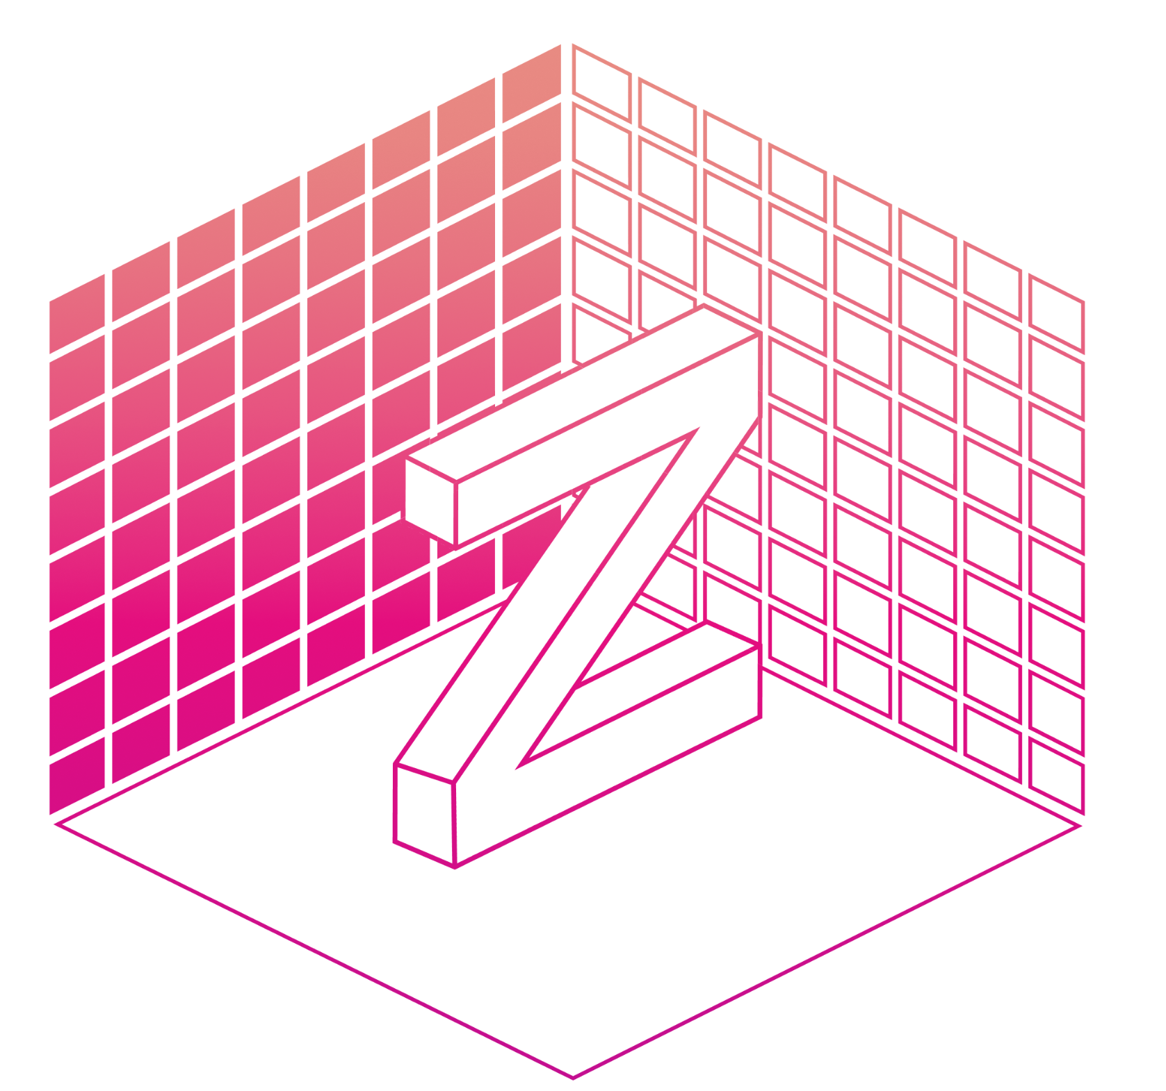


slides:
bit.ly/zarr-evolution-scipy-2023
Chunked, Compressed, & Cloud-native N-dimensional arrays
Maintenance and Evolution of Zarr

Slide 2


slides:
bit.ly/zarr-evolution-scipy-2023
Josh Moore
Sanket Verma
Zarr Steering Council @notjustmoore
Zarr Community Manager
@MSanKeys963
@zarr_dev

Slide 3

slides:
bit.ly/zarr-evolution-scipy-2023
Josh Moore
Sanket Verma
Zarr Steering Council @joshmoore@fediscience.org
Zarr Community Manager
@zarr@fosstodon.org

Slide 4
slides:
bit.ly/zarr-evolution-scipy-2023
So what’s my problem?

Slide 5


Mitocheck screen (~2003) 25TB, 200K videos Credit: Neumann et al., IDR (idr0013)

Slide 6
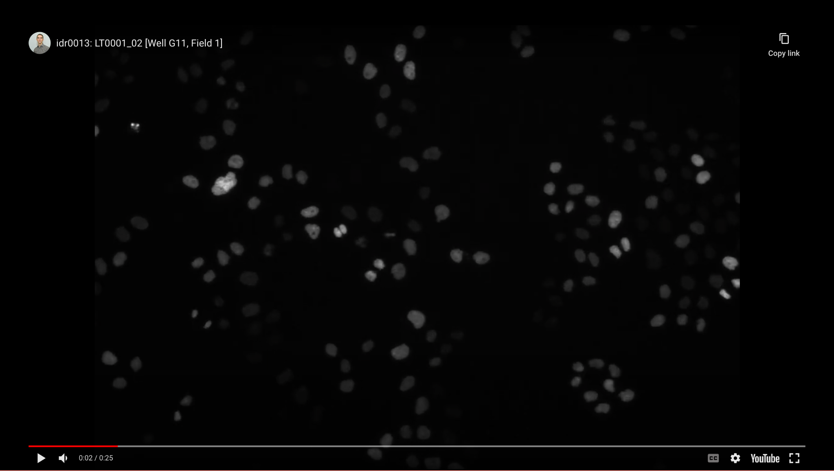
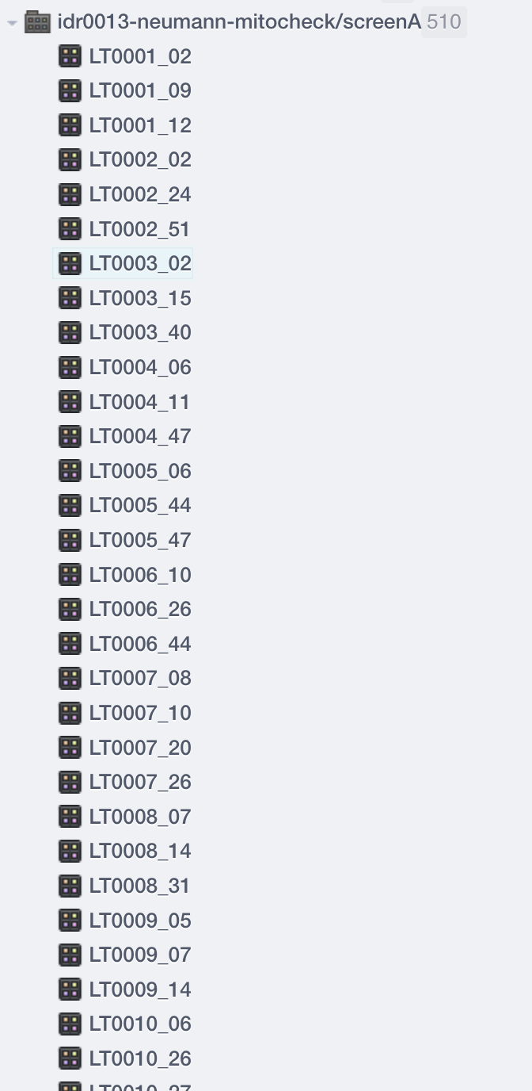
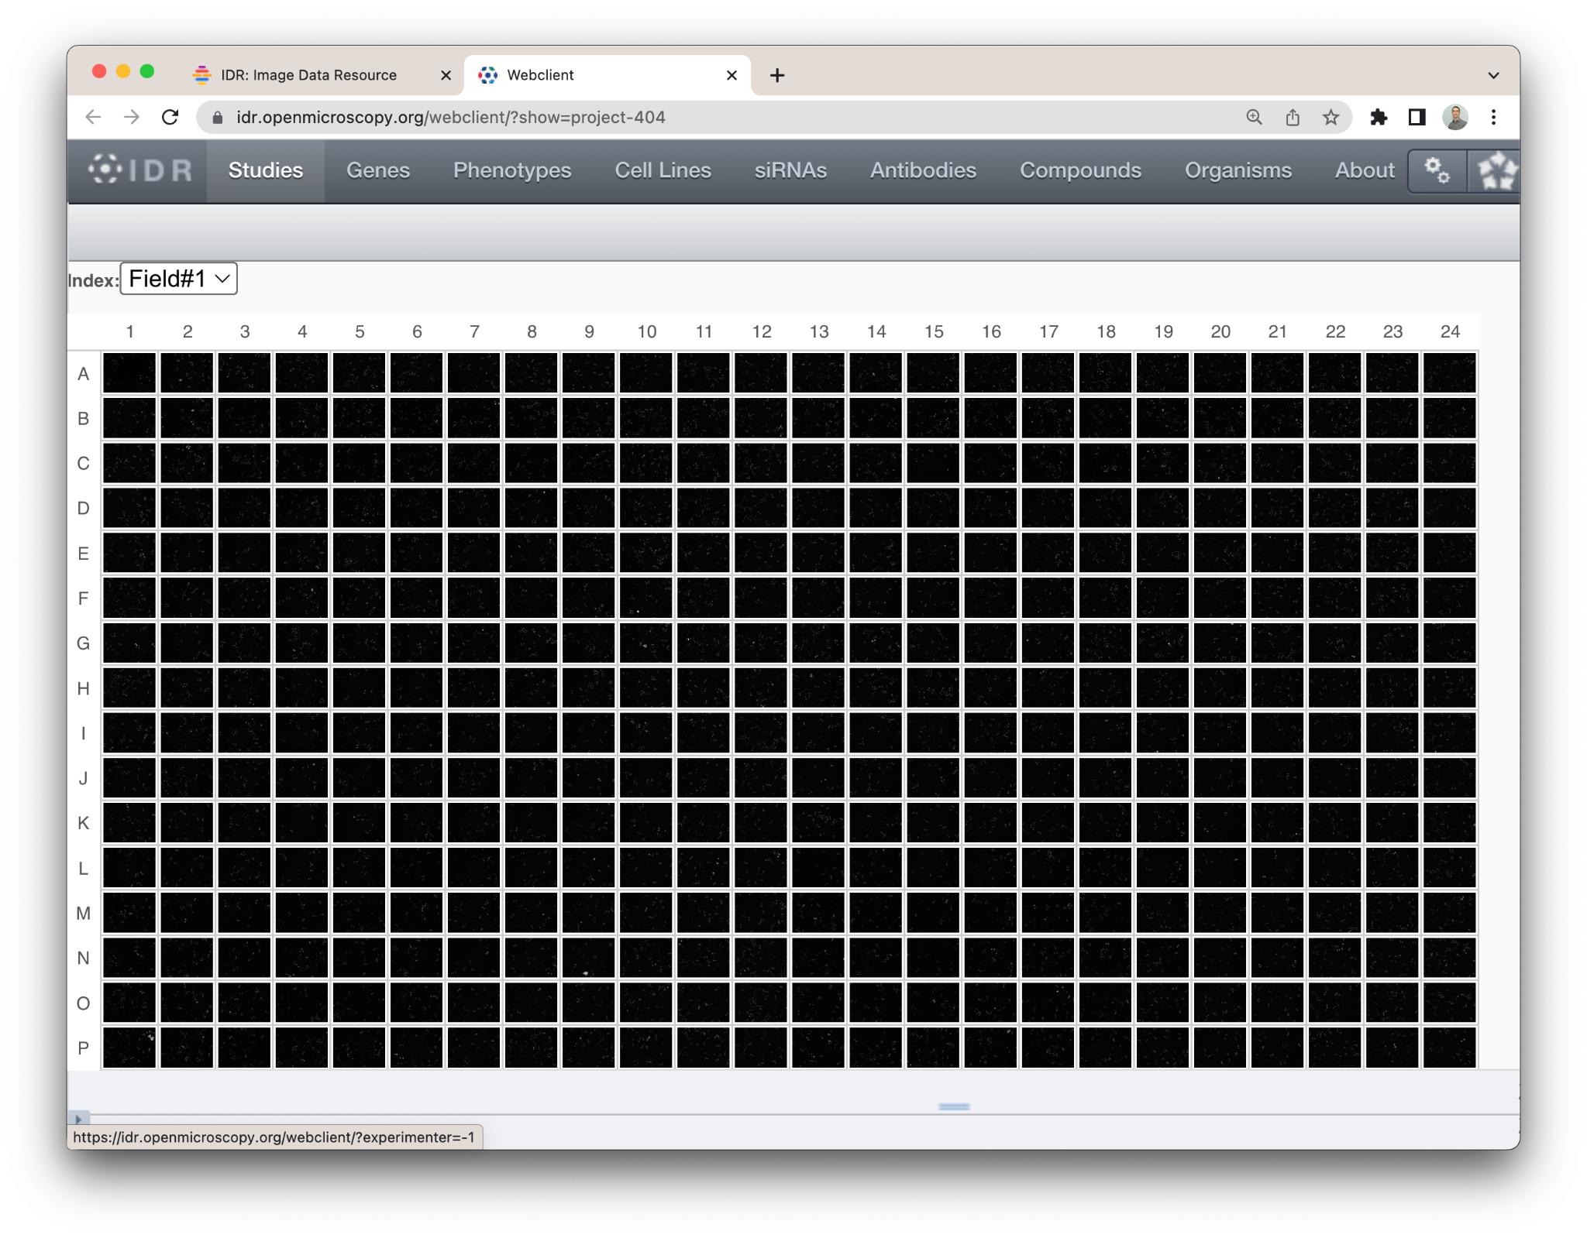
Mitocheck screen (~2003) 25TB, 200K videos Credit: Neumann et al., IDR (idr0013)

Slide 7
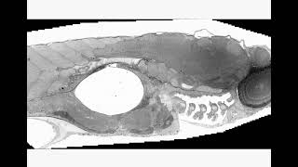
Zebrafish EM (~2012) 500 GB, 1 frame Credit: Faas et al., IDR (idr0053)

Slide 8
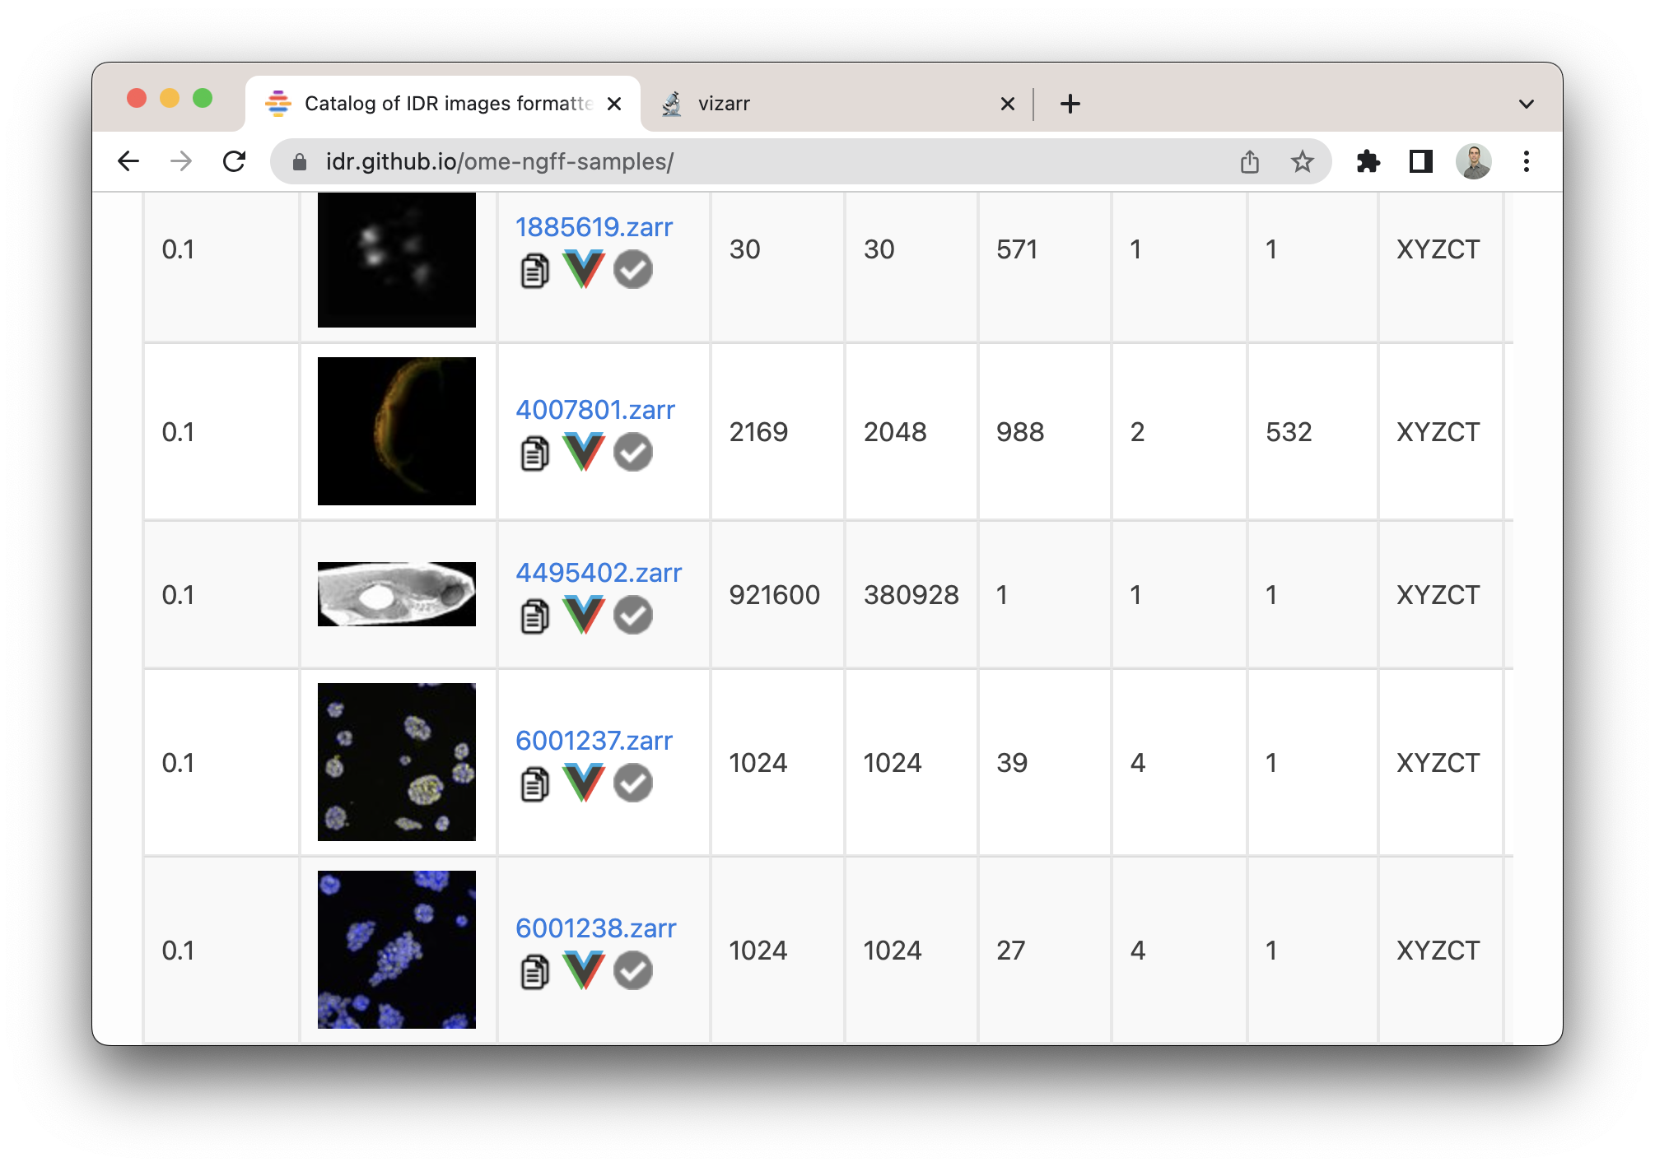
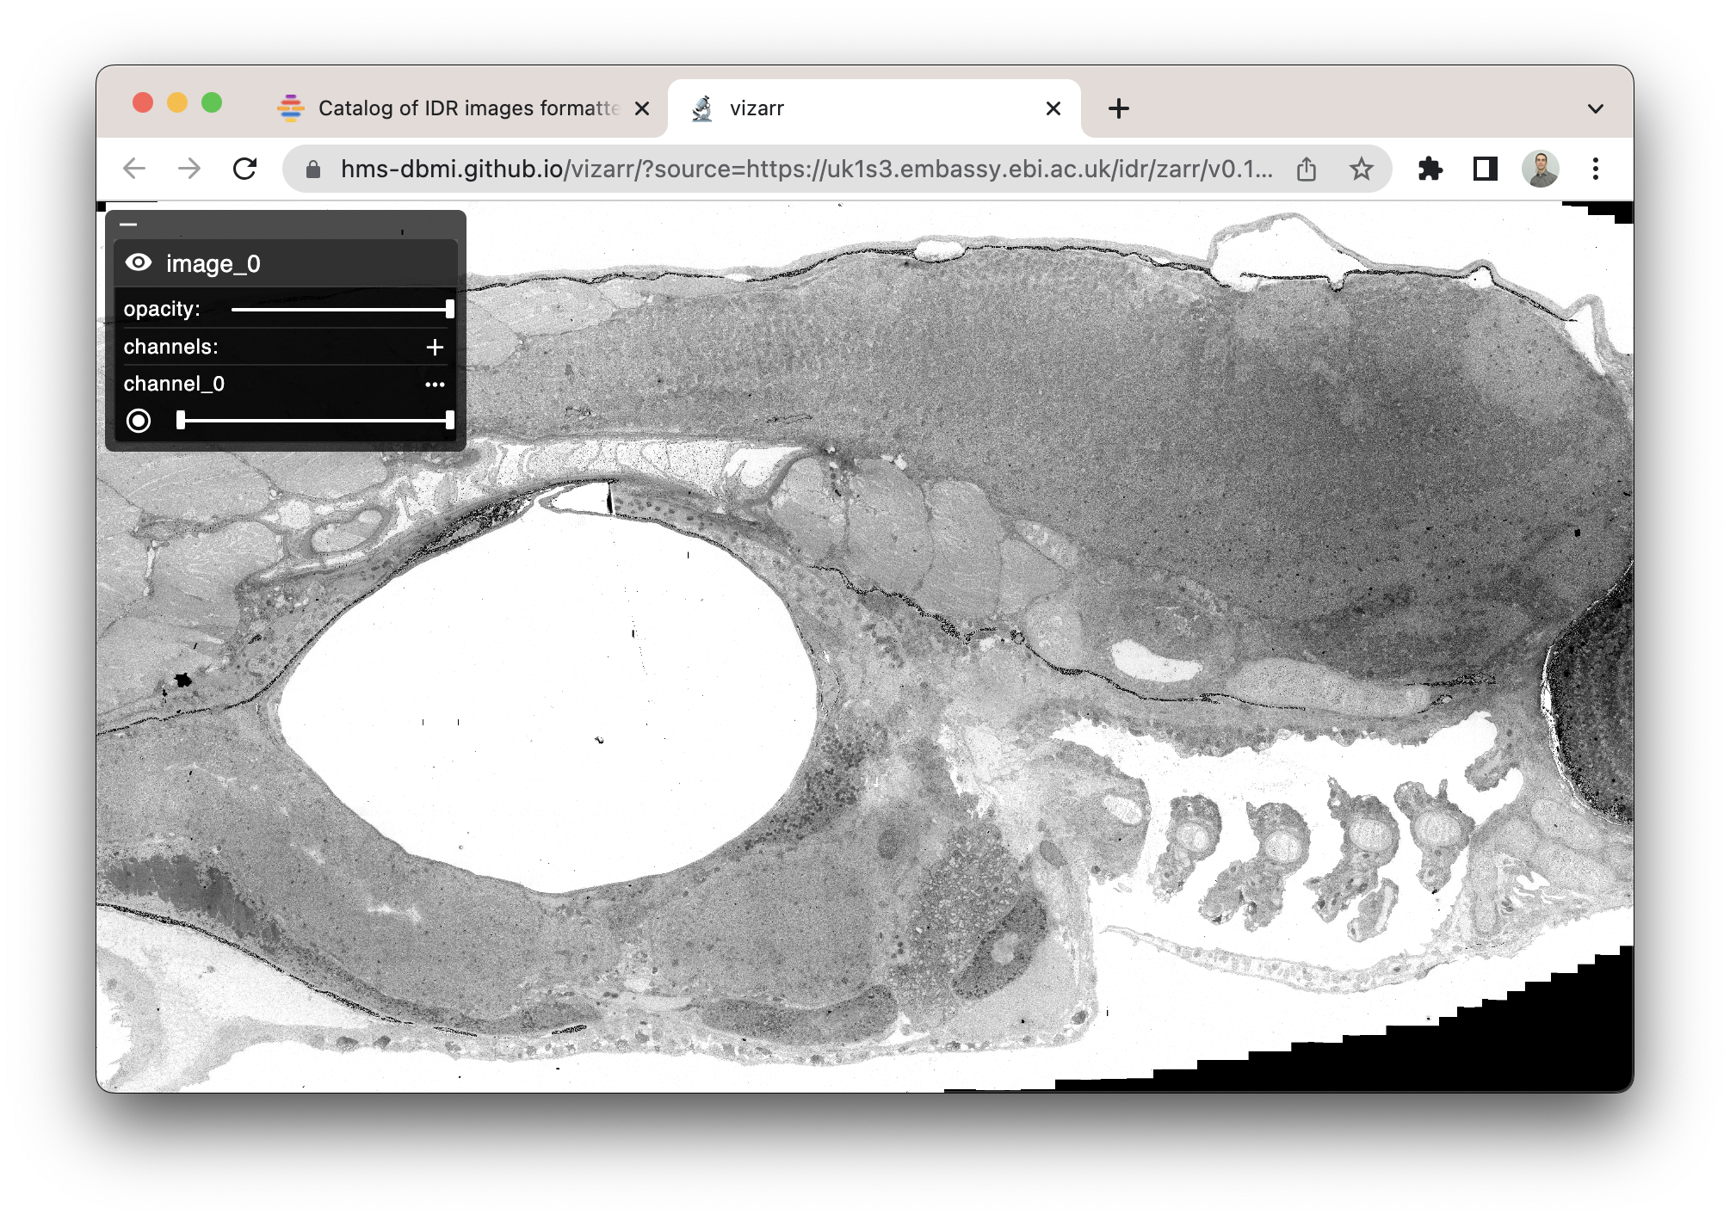

https://idr.github.io/ome-ngff-samples/
https://github.com/hms-dbmi/vizarr
https://www.buymeacoffee.com/manzt
Zebrafish EM (~2012) 500 GB, 1 frame Credit: Faas et al., IDR (idr0053)

Slide 9
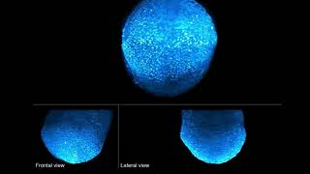
Mouse embryo (~2018) 5 TB, 1 volume Credit: McDole et al. Cell (10.1016/j.cell.2018.09.031)

Slide 10

TBD 10 PB, “1 brain” Credit: https://knowyourmeme.com/

Slide 11
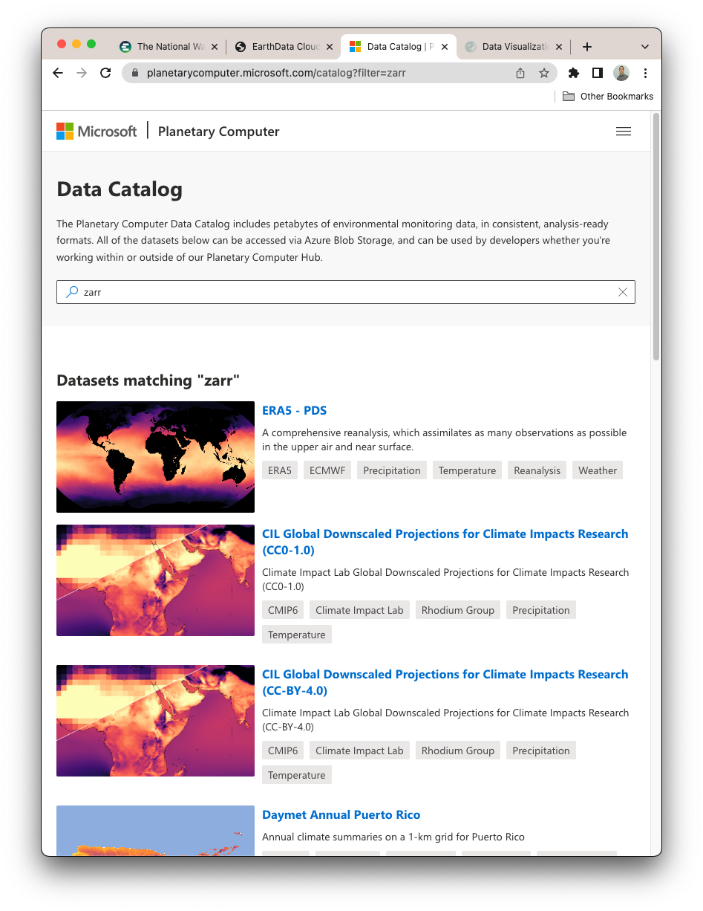
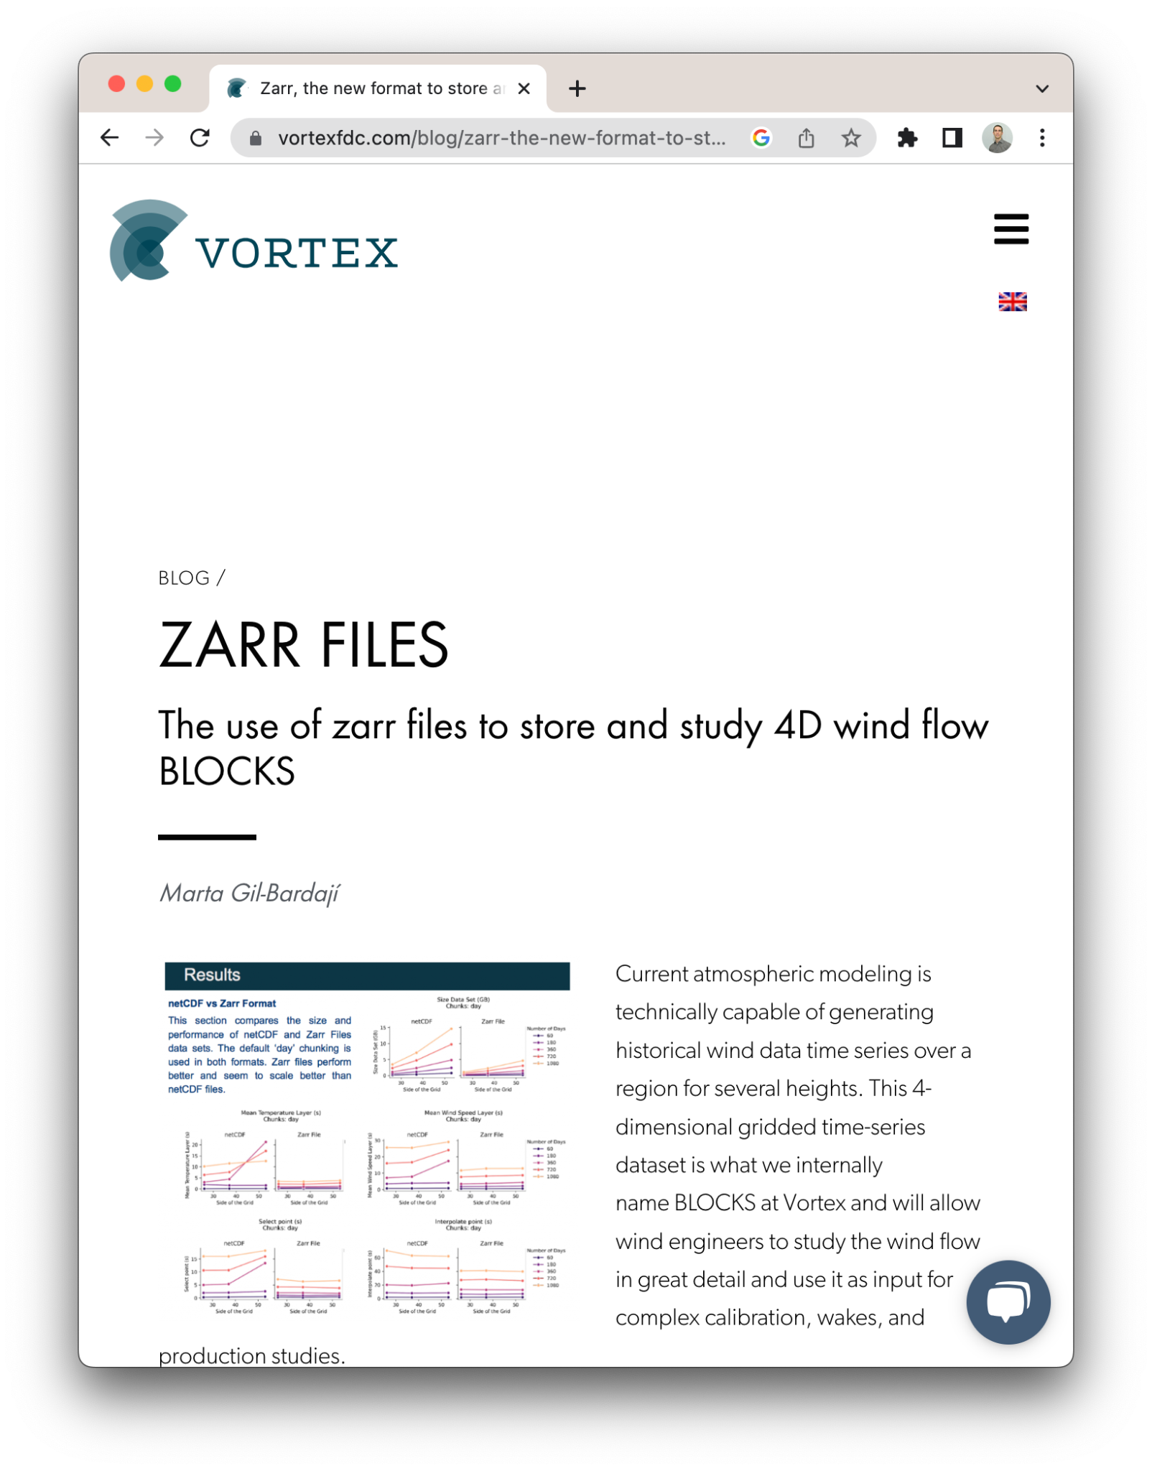
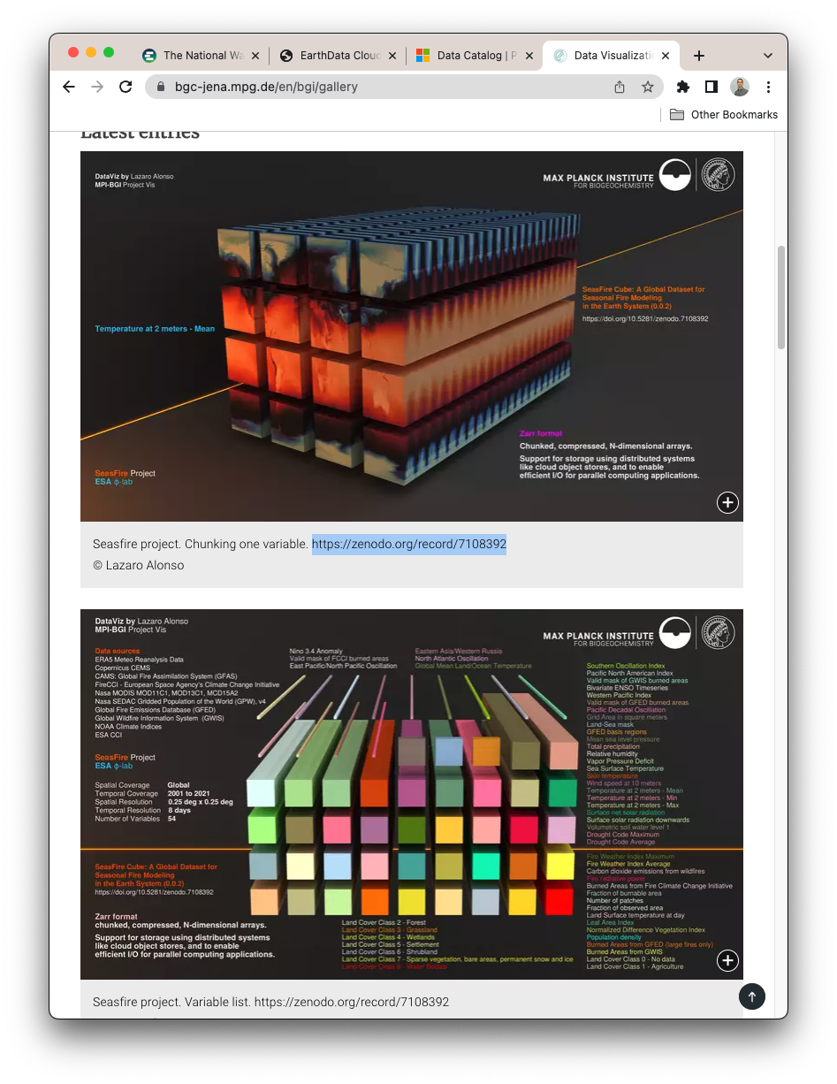

Earth
Wind
Fire
(Water, etc.)

Slide 12



Benefits of Zarr
Distributed & Cloud Storage Chunked Storage
Built-In Compression
Notes:
Simple. → Spec.

Slide 13
How Zarr works?

Slide 14
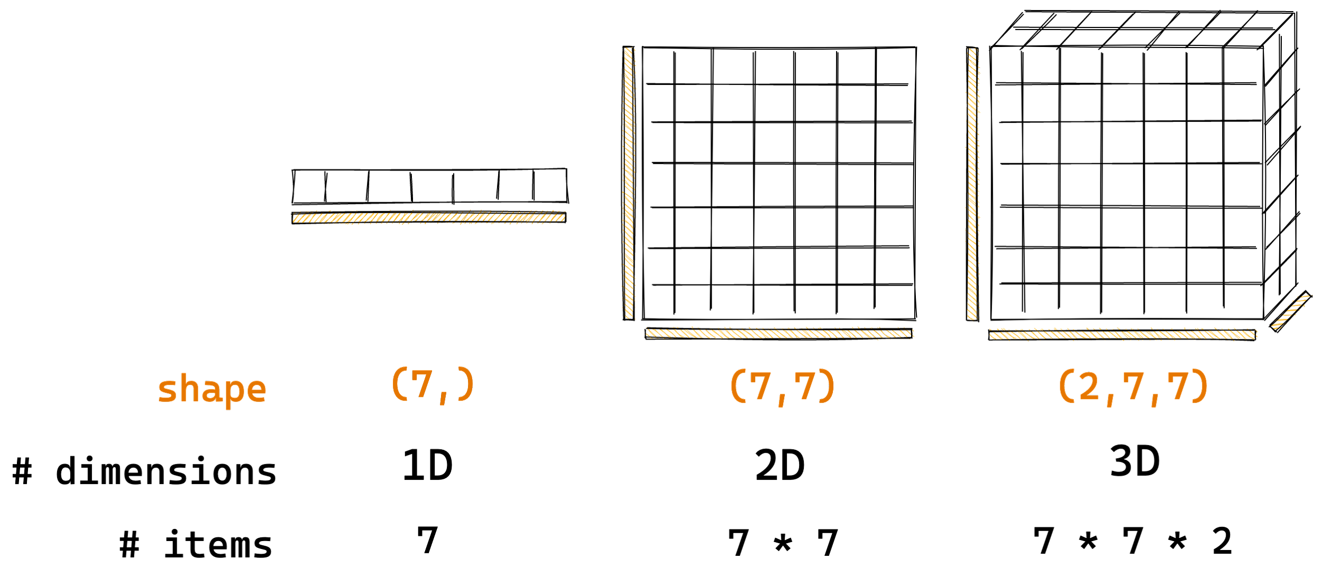
How Zarr works?
Arrays are container of items of the same data-type & size (in bits). The number of dimensions and items in container are described by the shape.
Credit: @trevmanz

Slide 15

How Zarr works?
So take the arrays you know and love?
Credit: @trevmanz

Slide 16
How Zarr works?
What if the data is too big to fit in memory?
Credit: @trevmanz

Slide 17
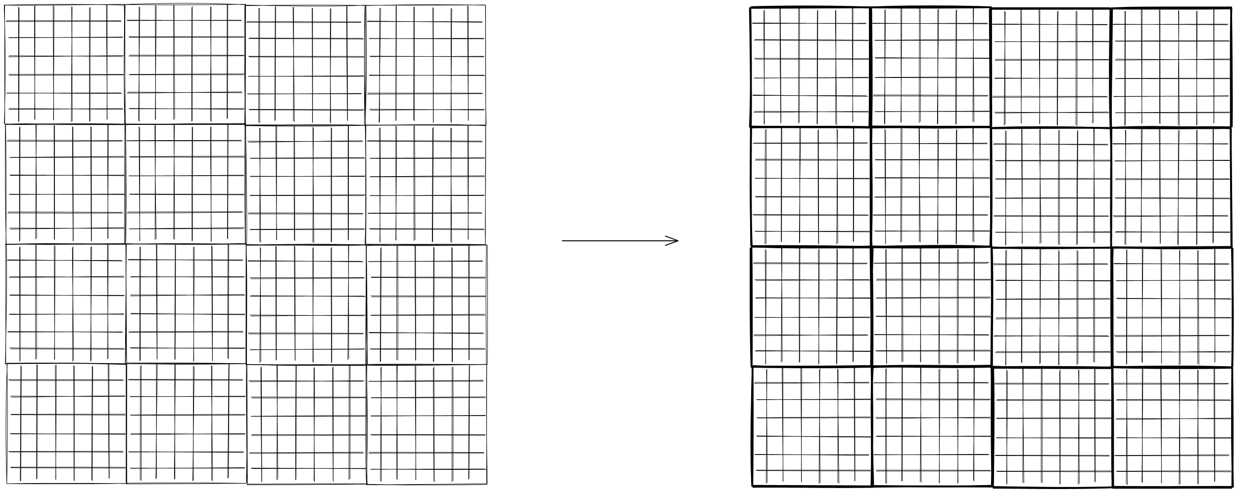
How Zarr works?
Divide array into chunks (Chunking)
Credit: @trevmanz

Slide 18
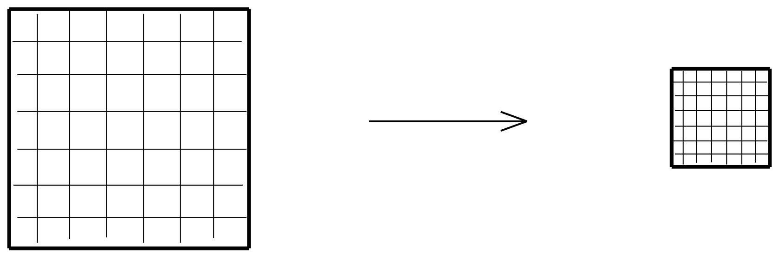
How Zarr works?
Compress each chunk
Over 20 supported compressors (BLOSC, Zstd, Zlib etc)
Credit: @trevmanz

Slide 19
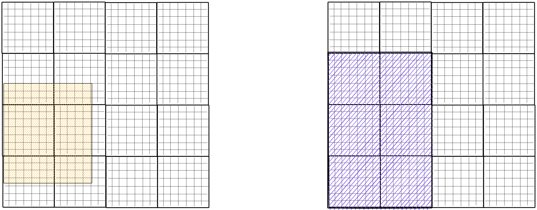
How Zarr works?
Retrieve chunks only when needed
Credit: @trevmanz

Slide 20
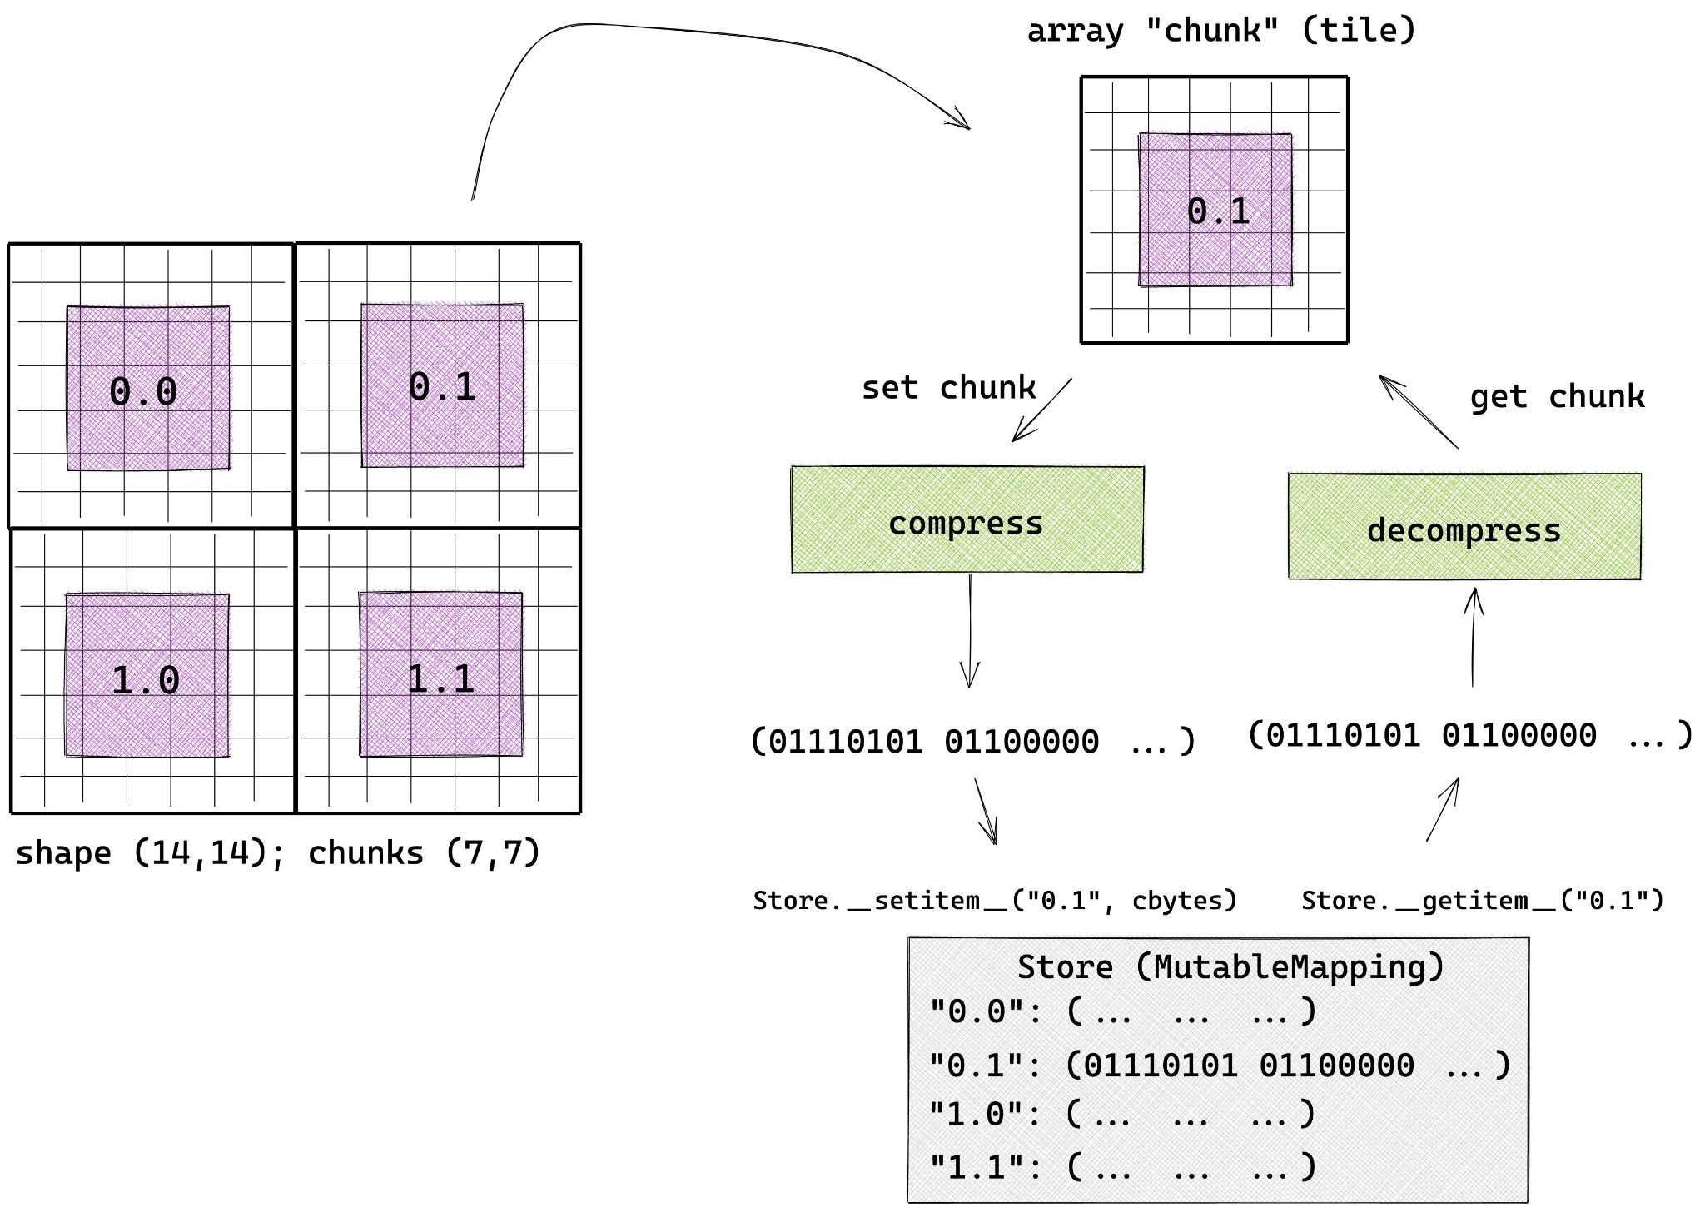
How Zarr works?
Credit: @trevmanz

Slide 21
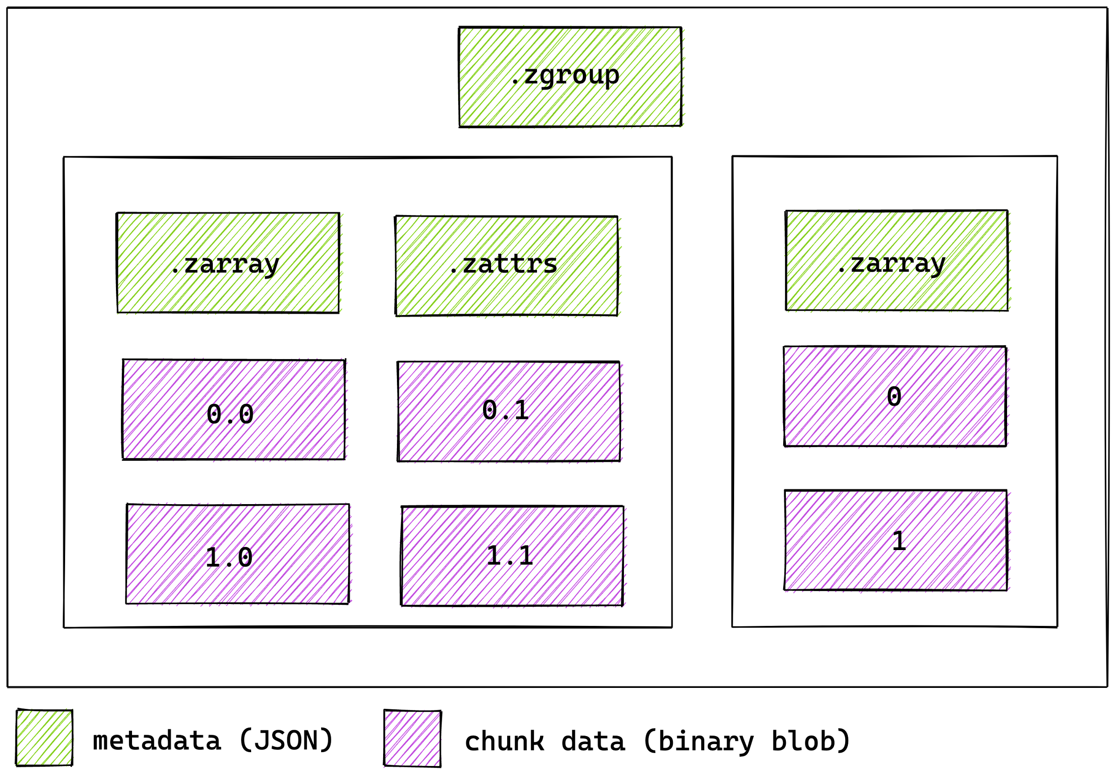
How Zarr works?
Multiple arrays can be organised in hierarchies of groups
Credit: @trevmanz

Slide 22
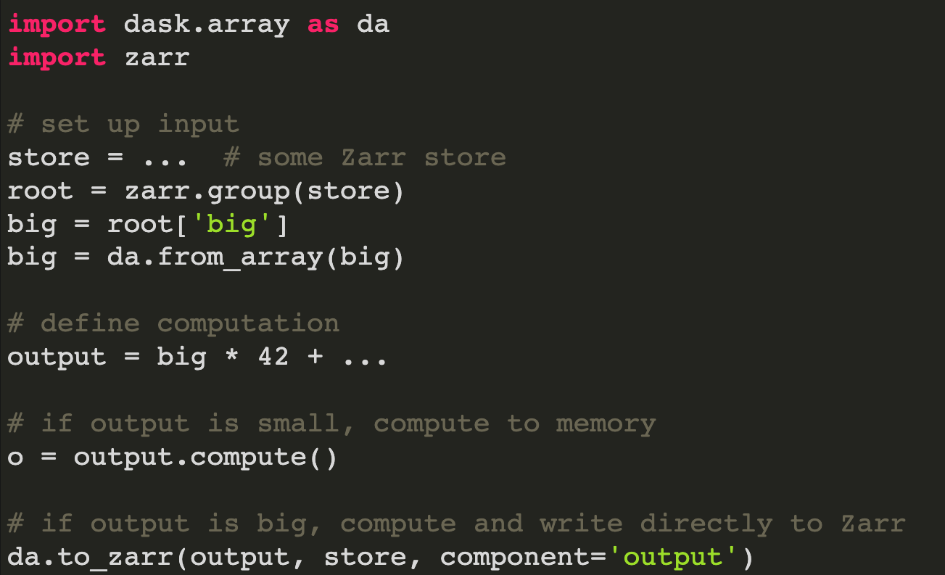
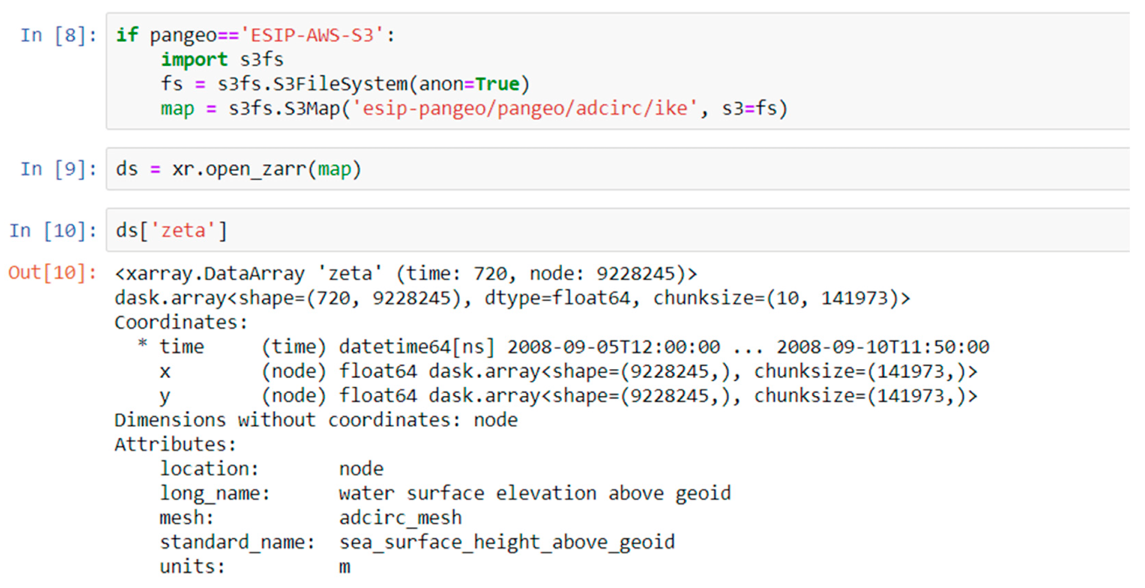

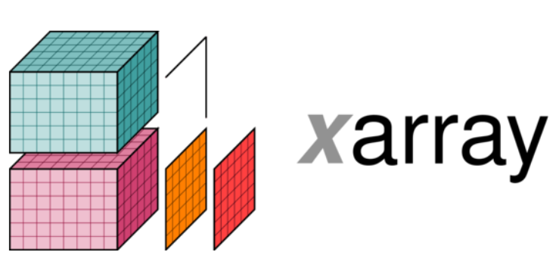
da.from_array & xr.open_zarr
Integrated methods through the PyData ecosystem
Credit: Alistair Miles https://zarr.dev/slides/scipy-2019.html#/8/1
Credit: Richard Signell https://www.mdpi.com/2077-1312/7/4/110

Slide 23

Zarr Specification
V1 → V2 → V3
https://zarr-specs.readthedocs.io/

Slide 24
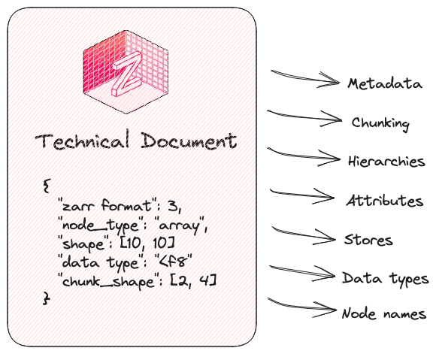
Zarr Specification

Slide 25







↔

Slide 26
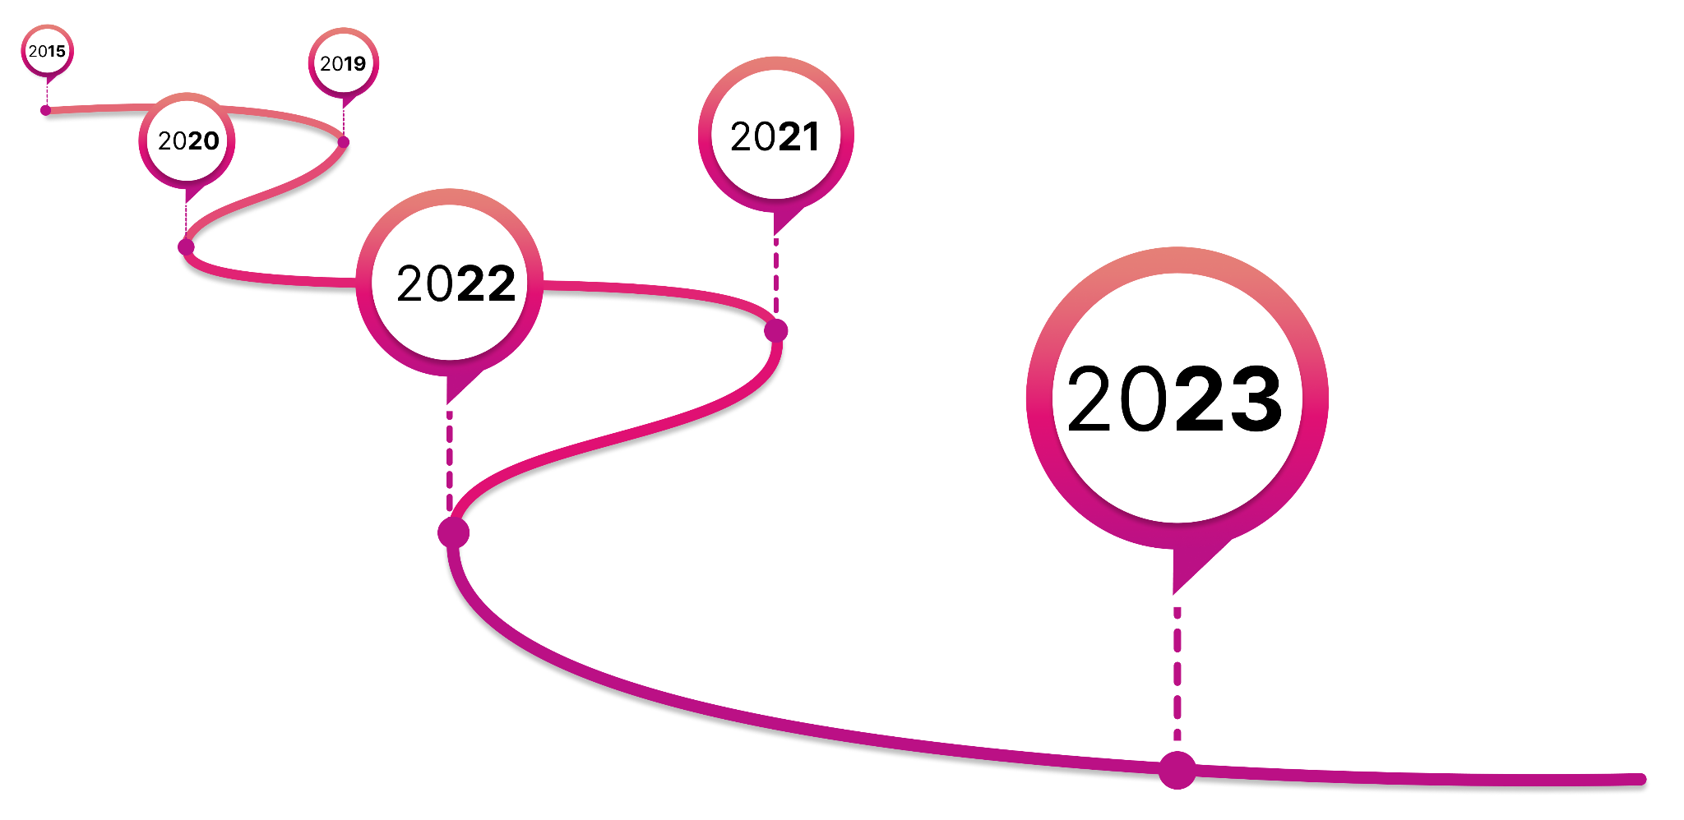
Timeline
First commit
SciPy (Alistair Miles)
Work on V3 begins
https://zarr.dev
New Logo
CZI Grant #1
NumFOCUS
Steering Council
CZI Grant #2
Community Manager
Enhancement Process
ZEPs
SciPy!

Slide 27
Zarr Community

Slide 28


Slide 29
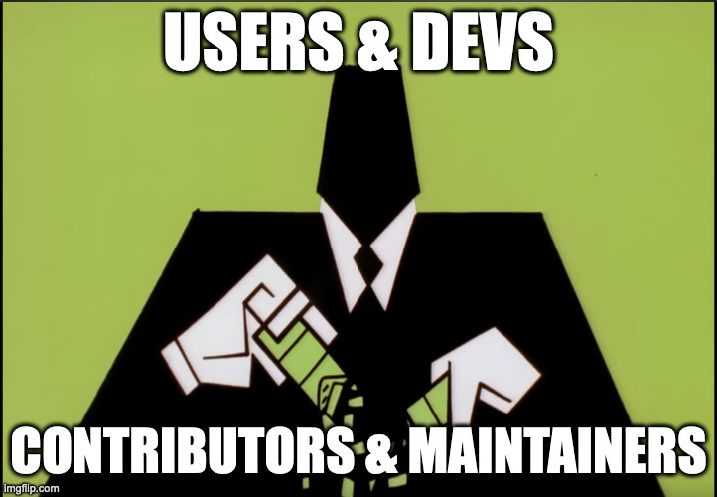

Slide 30
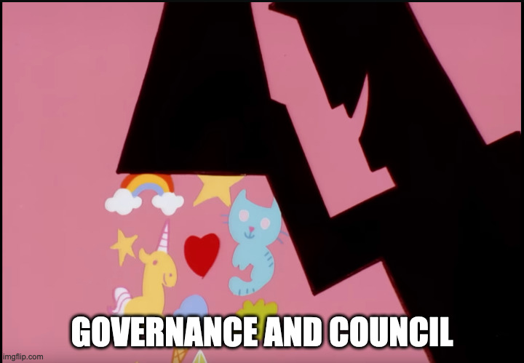

Slide 31


Slide 32
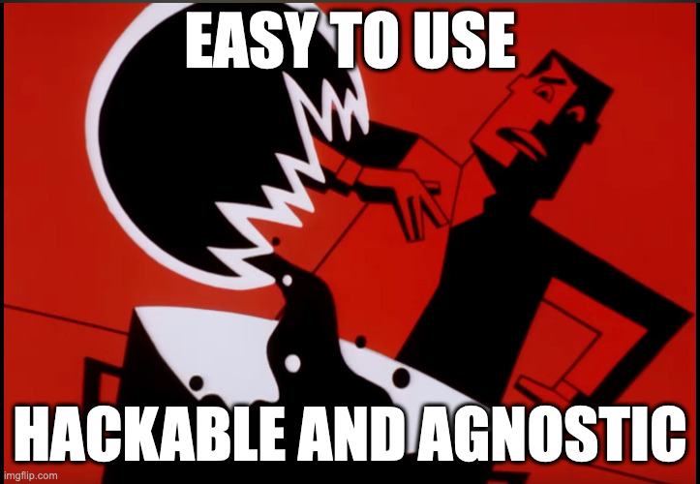

Slide 33
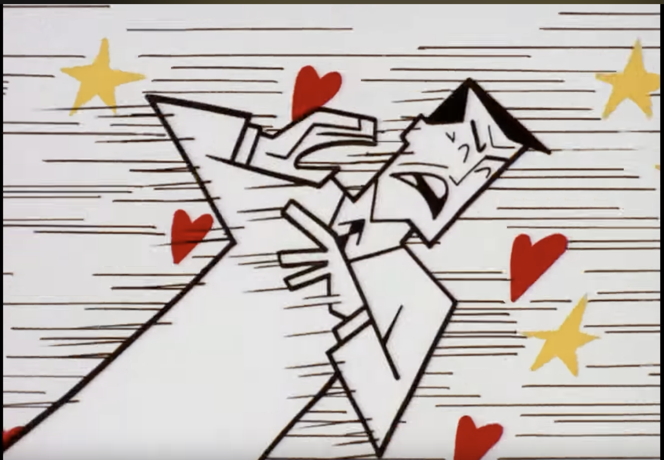

Slide 34


Slide 35


Slide 36
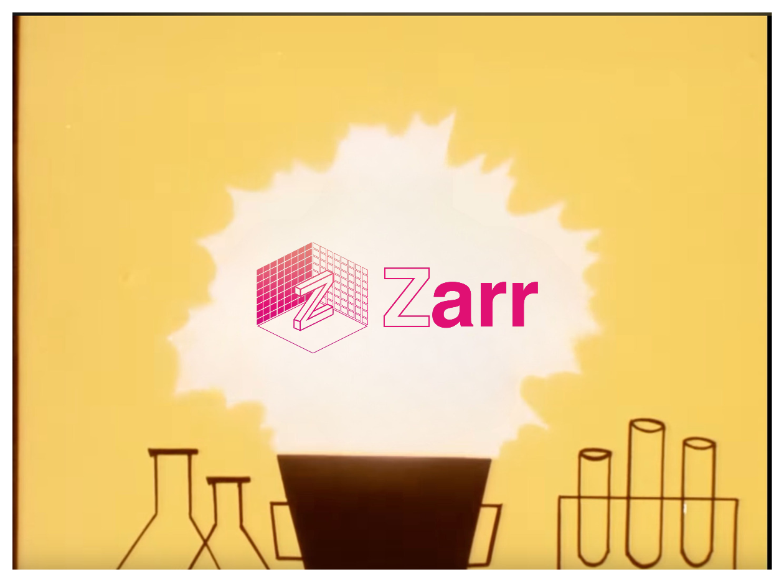

Slide 37
We have a large and diverse active community!
But…👀

Slide 38
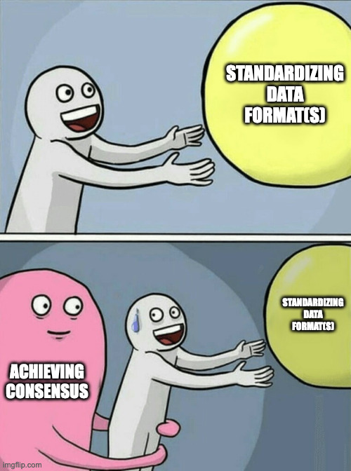


Slide 39
We needed a structured way to solicit and *process* the feedback!

Slide 40
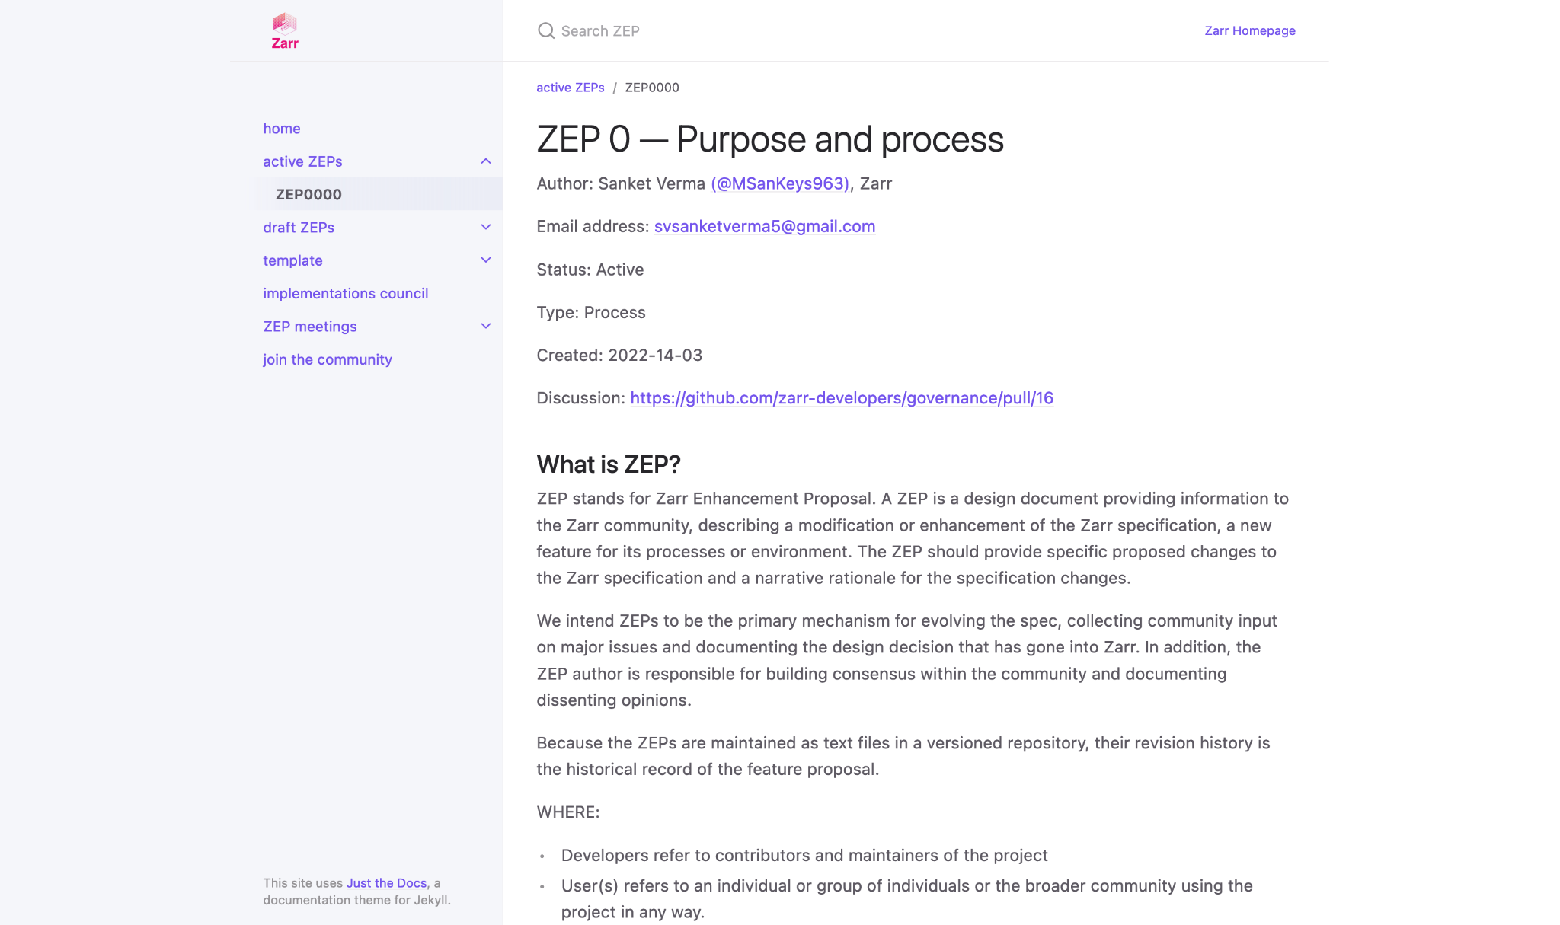
zarr.dev/zeps

Slide 41
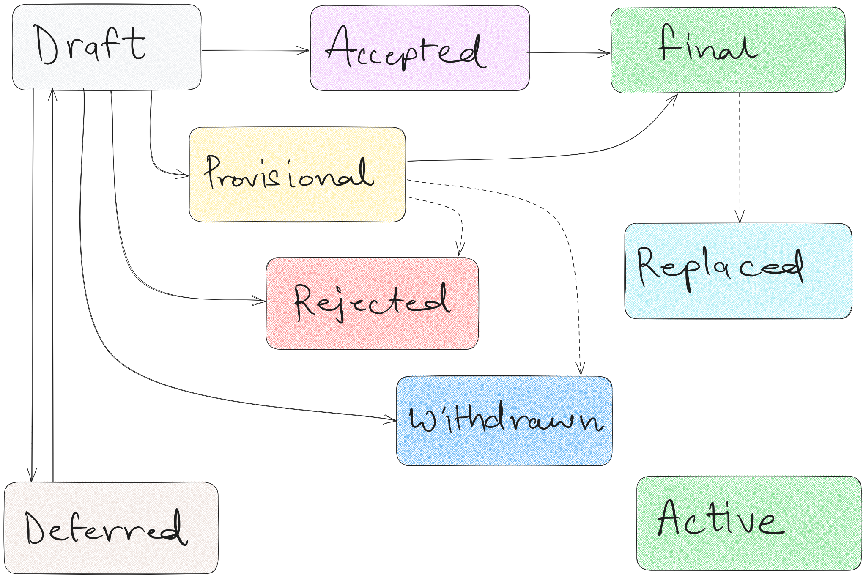
ZEP Flowchart ⤴↖↔

Slide 42
How we did it?🚶🏻‍♂️

Slide 43

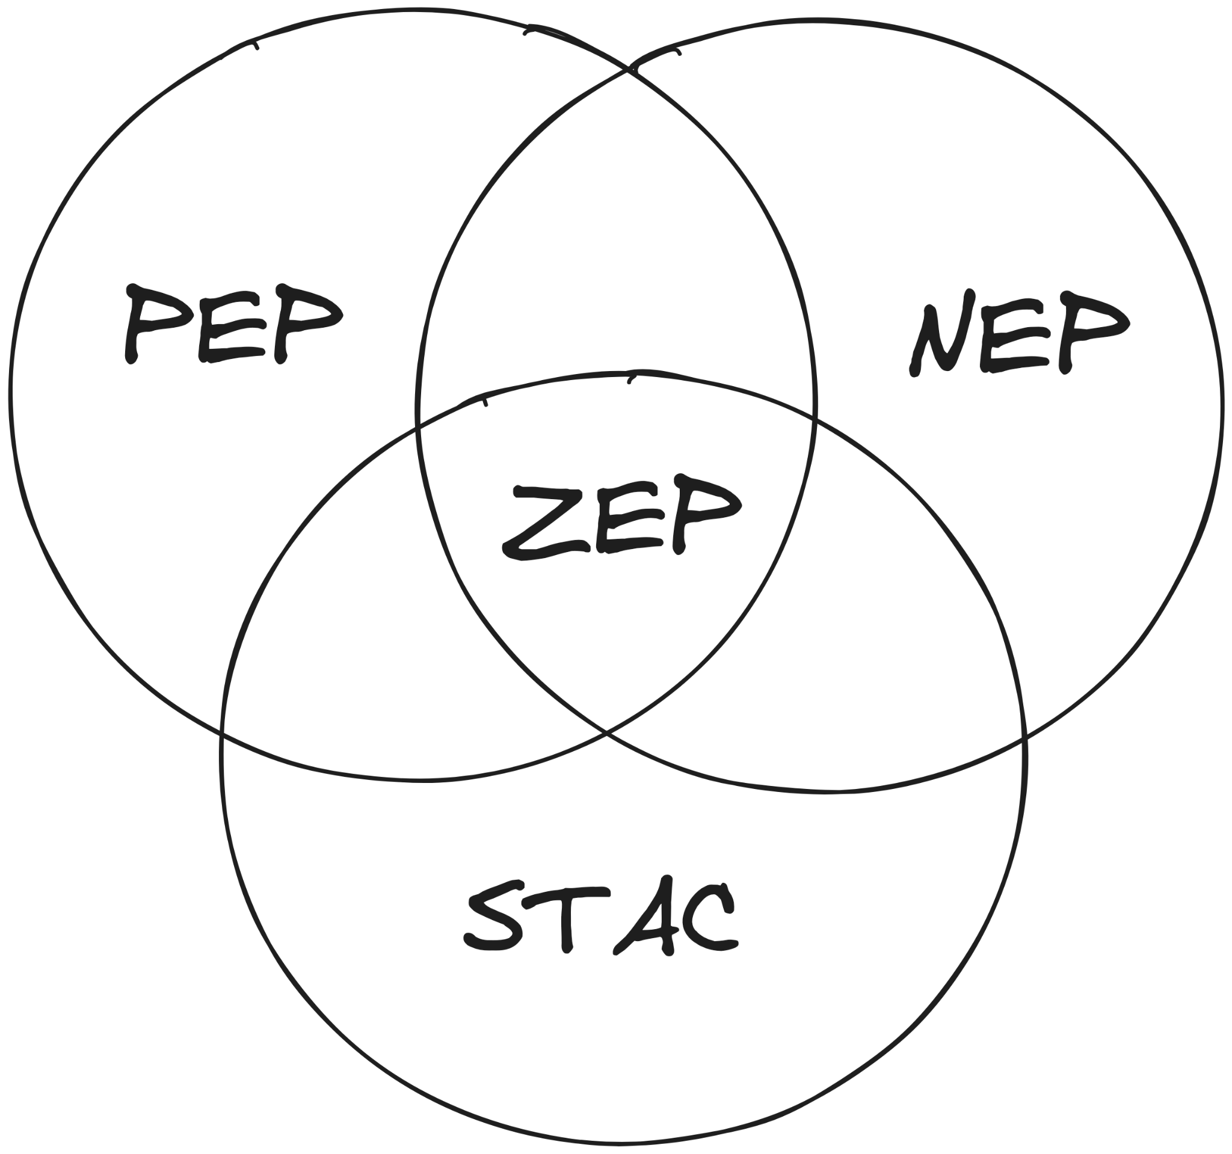

Lots of Reading
Previous Experience
Understanding the needs of the community

Slide 44

Braindump 🧠
ZEP Inception Blog post

Slide 45
How do we adopt a ZEP?

Slide 46


→

Slide 47
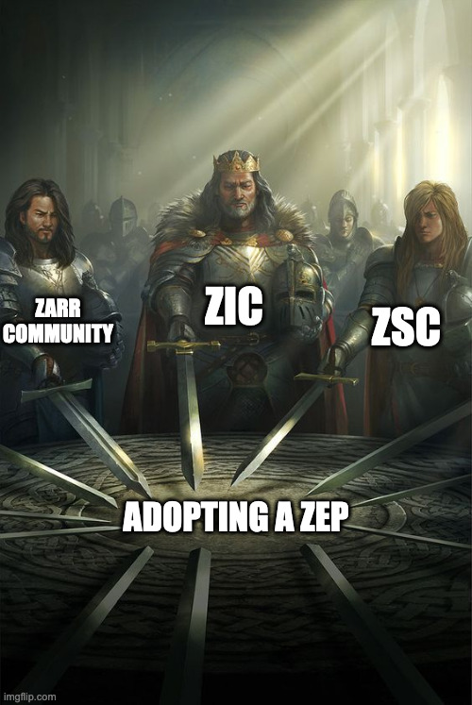

Slide 48

🚧
Work in progress! 👷‍♂️
Notes:
ZEP0 is a living document
We’re always looking to improve it

Slide 49
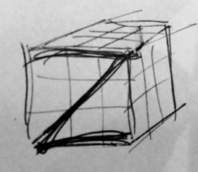


Evolution
→
→
👶🏻
👦🏻
👨🏻

Slide 50
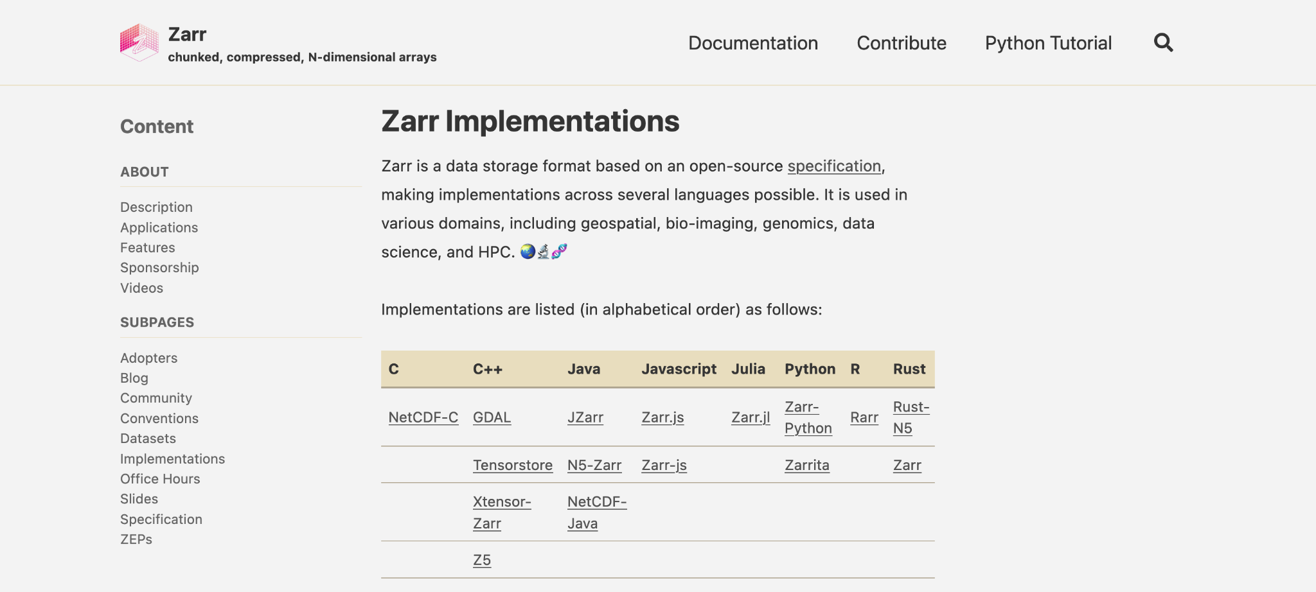
zarr.dev/implementations

Slide 51
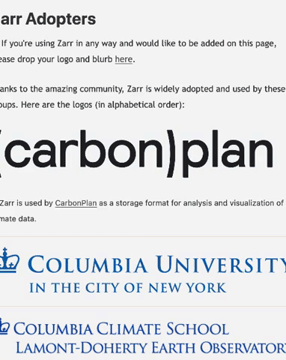
zarr.dev/adopters

Slide 52



/zarr-developers/{gsoc,outreachy}

Slide 53
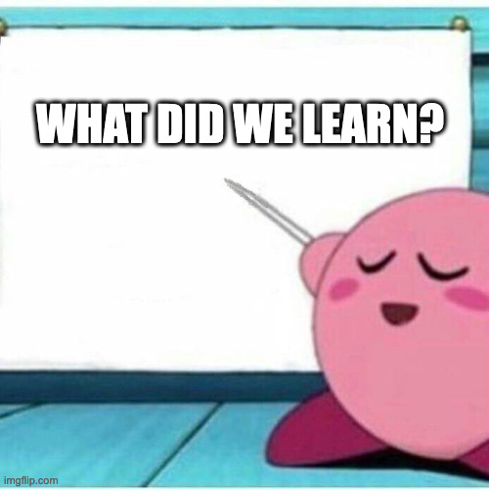

Slide 54
Lessons 📖
→ Creative ways to foster the community & OSS 🎨
→ Establishing trust is critical for standardization 🤝🏻
→ Everyone on the same page - difficult but achievable 🔗
→ Be considerate to everyone! 🫀
Notes:
There are various creative ways to take care and maintain the project
Adopters need to trust the project’s workings and governance for interoperability
Trust is critical for standardization of the project - and we’ve been working on various elements for those
Ease of use
Openness
Soliciting feedback
Interacting and participating in outreach programs
Be human and considerate and patient for response
Most of the times developers contribute to the OS project in their free time, and sometimes it takes time to get a response - in that case be patient

Slide 55

Thank you! 🙏🏻
@zarr_dev

